Slide 1
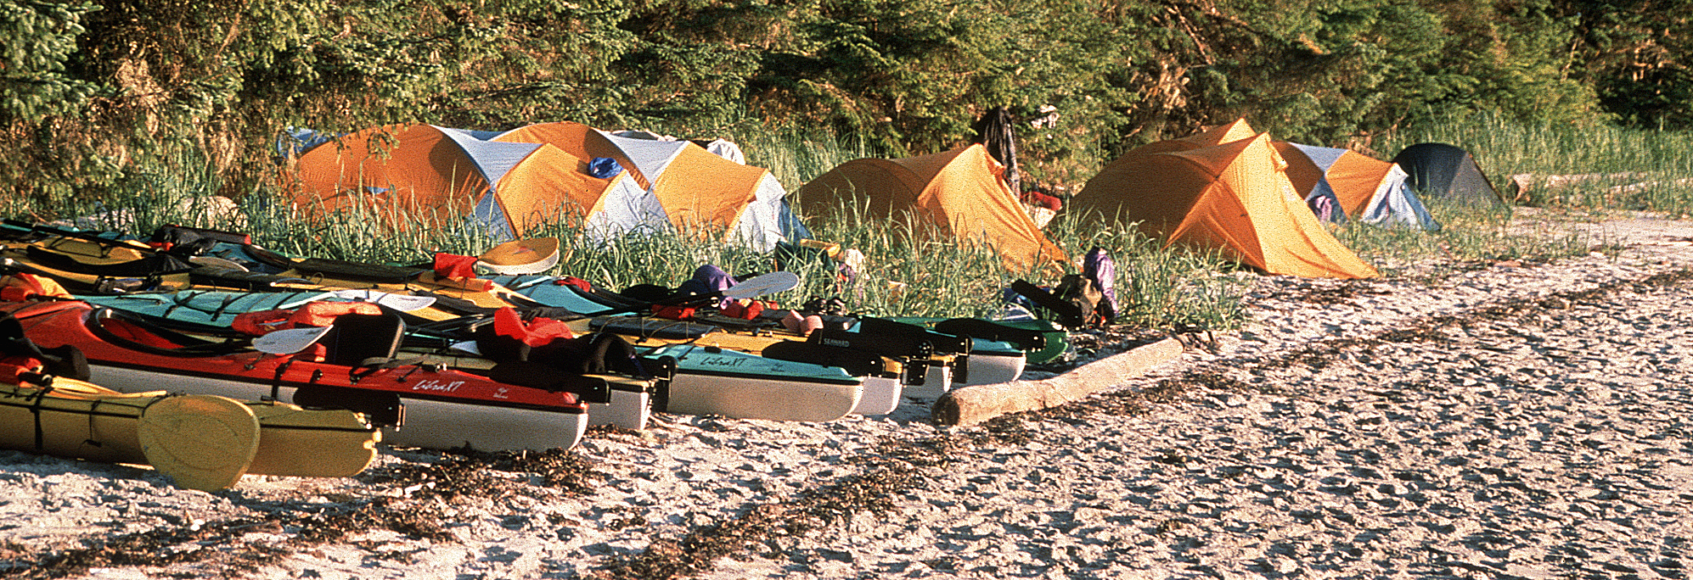
Tourism and Forestry - Working Together
North Island – Central Coast Resource District
Forest Management Leadership Team
October 8, 2015

Slide 2
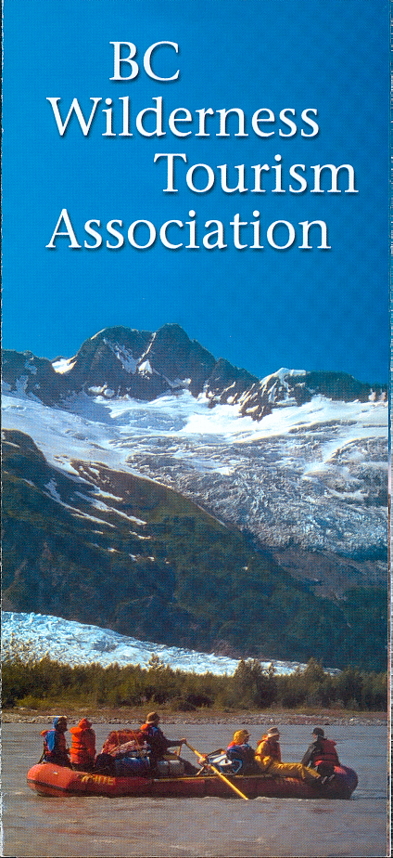
Wilderness Tourism Association of BC
Founded in 1999, the WTA works to ensure a sustainable future for BC’s wilderness tourism industry through Leadership, Advocacy, and Stewardship
Protect BC’s wilderness landscapes, marine areas and intact functioning ecosystems, and secure access to wilderness tourism opportunities.
Protect Super, Natural British Columbia ®

Slide 3
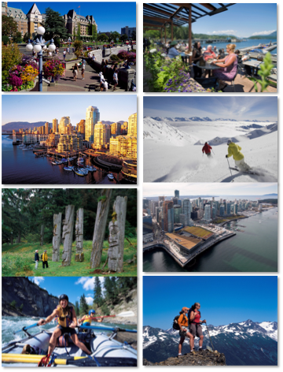
Tourism in British Columbia
The world sees BC as:
a welcoming place; a safe place
untamed but also sophisticated
having spectacular natural beauty
a unique mosaic of culturally-rich and vibrant communities
providing exceptional experiences
Our Competitive Advantage:
Growing demand for BC experiences
Super, Natural British Columbia ®
Appeal to Boomers/new markets
Rich in Crown lands & World class Parks

Slide 4

Tourism in British Columbia
Tourism Revenue: $13.8 Billion
BC GDP Contribution: $7.1 Billion
Export Revenue: $3.2 Billion
Provincial tax: $1.2 Billion
25 million annual tourists
18,034 tourism-related businesses
127,300 employees (1 / 15 people employed in the province)

Slide 5
Nature Based Tourism in BC
2,250 Businesses, 16,000 Employees
Approx. 980,000 clients, 3 million client days
$1.5 billion in revenue (net of pre and post service revenues)
NBT is a major driver of BC’s $13.8 billion in tourism revenues.
Direct, indirect and induced estimates | Operations | Investment
Revenue $Millions | $2,854.6 | $36.5
GDP | $1,566 | $18.4
Taxes | $413.2 | $1.6
Employment Person Years | 22000 | 215

Slide 6
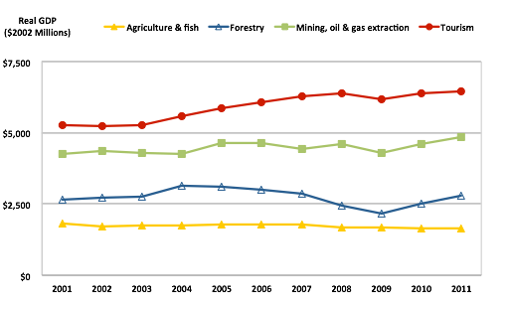
Real GDP, for Select Sectors - 2001-2011

Slide 7
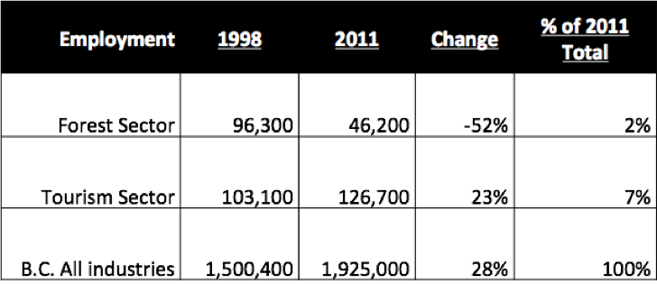
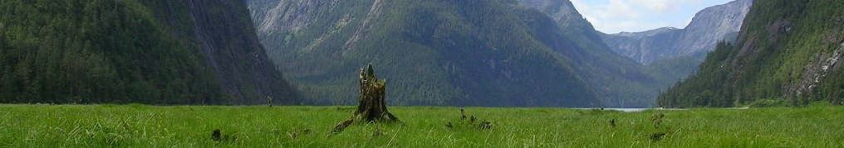
Employment - Forest and Tourism Sectors

Slide 8
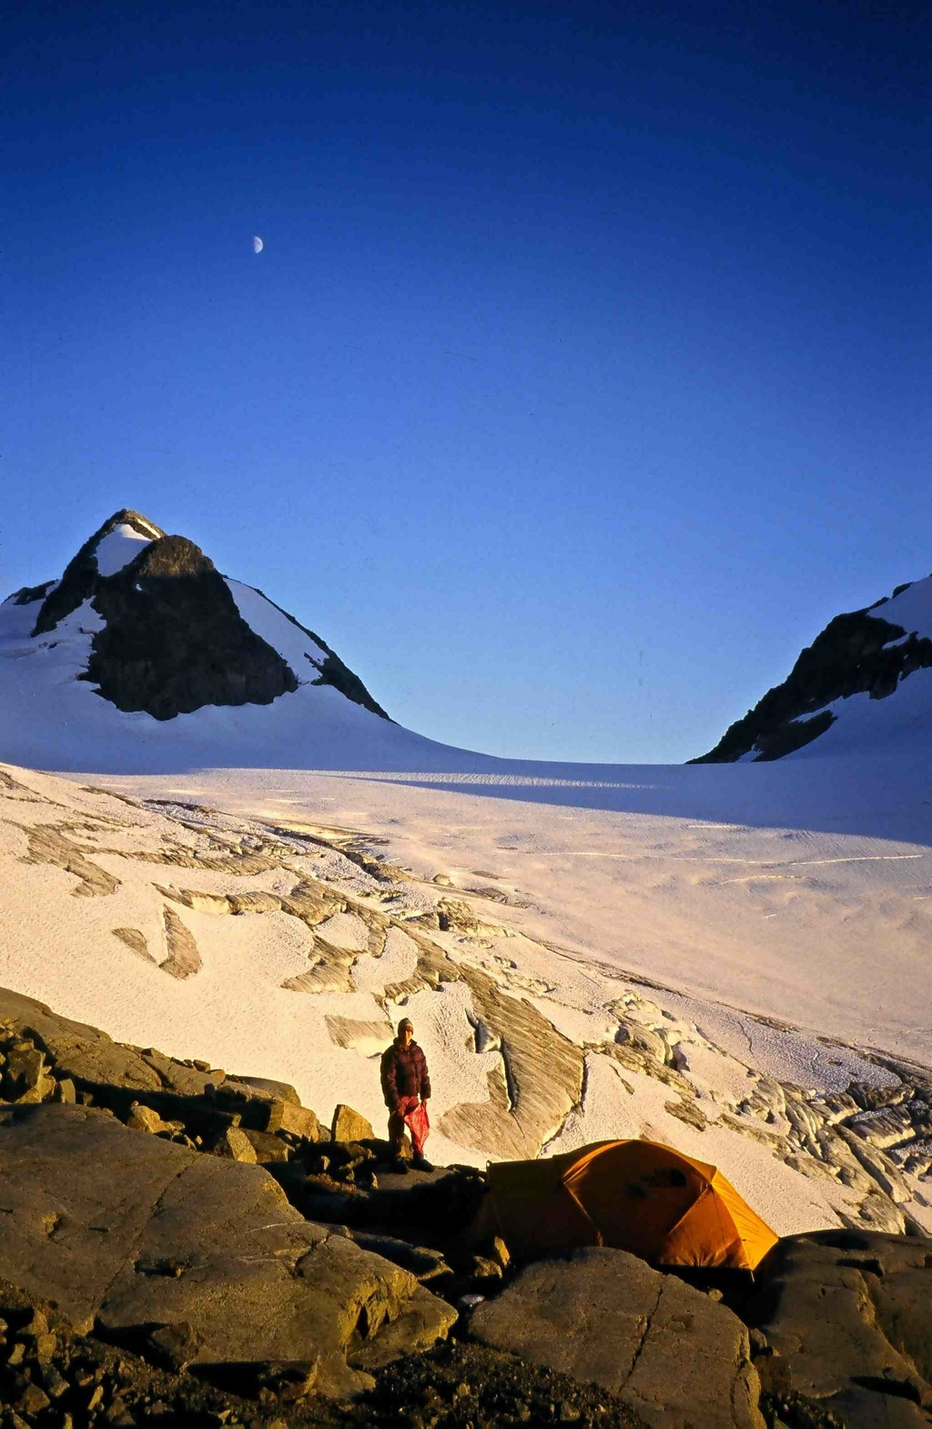
Opportunities
High quality natural environment is the main attraction that draws NBT visitors to the area and to select tourism products.
Primary Importance
Natural Setting
Secondary Importance
Preferred Activities
Importance of Facilities
and Services

Slide 9
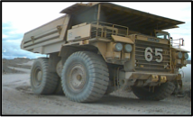
Challenges/Constraints
  Competition for natural resources among multiple industries, in particular forestry.
  Lack of security for land tenuring.

Slide 10
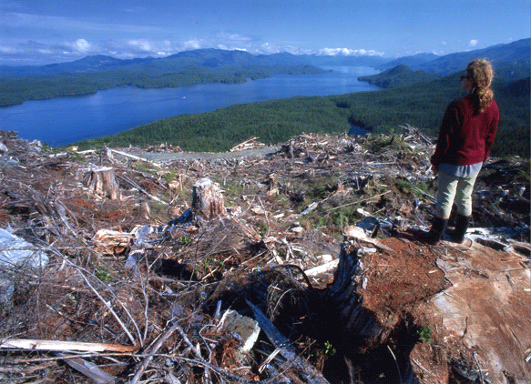
Tourism and Forestry
The Issues:
Quality of viewscapes;
Environmental practices;
Fisheries values;
Recreation features and trails;
Seasonal operations;
Changes in access;
Safety hazards; and,
The rate of planned development, harvest and reforestation;
Communication with stakeholders - site level planning.
The problem: a regulatory and planning framework with a strong bias towards forestry being the dominant activity on the land base.

Slide 11
What the tourism industry needs
A better notification and consultation (info sharing) framework. Regs or policy.
Site planning info with relevant operational details (e.g block layouts, road alignments and visual modelling, etc).
Increase VQOs where required.
Use recreational objectives where warranted and consider developing “wilderness” or “remote” objectives
LU planning or GAR orders.

Slide 12

A shared interest
Both the forestry and tourism sectors are important to BC economically and culturally. Both reliant on the same natural resources
There is a need for these two sectors to work together so that both can prosper, and continue to contribute to the provinces GDP and jobs.

Slide 13
A Way Forward
Government is looking for balance between sectors
Legislation only gets us part-way to meeting our goals …. need to work together to achieve the rest of it.
Opportunities to work together, e.g. MOUs, stakeholder forums
Understanding Sector Needs? Enabling coordination/compromise.
Business Awareness – Who is around? How to communicate?
Better monitoring, e.g. FREP, MRVA reports, etc.

Slide 14
FRPA Recommendations
  Recommendation 1.
  Complete higher-level direction to guide planning and practice
  Finalizing a clear and comprehensive suite of Government objectives for forest and range values.
  Improving the process for establishing objectives under GAR.
  Recommendation 2.
  Improve stakeholder and public engagement in operational planning
  Working with stakeholders, industry and professionals to identify and promote examples of stakeholder and public engagement in operational planning that are working well.

Slide 15
FRPA Recommendations
  Recommendation 3.
  Clarify roles, accountabilities and authorities for delivering FRPA
  Working with industry and professional associations to clarify the respective roles, accountabilities and authorities of Government, licensees and professionals under FRPA;
  Better utilizing local decision-makers in mediating significant resource user conflicts;
  Providing guidance and training to local decision-makers, licensees and professionals on key aspects of FRPA implementation (i.e., use of non-legal guidance, development and approval of operational plans).

Slide 16
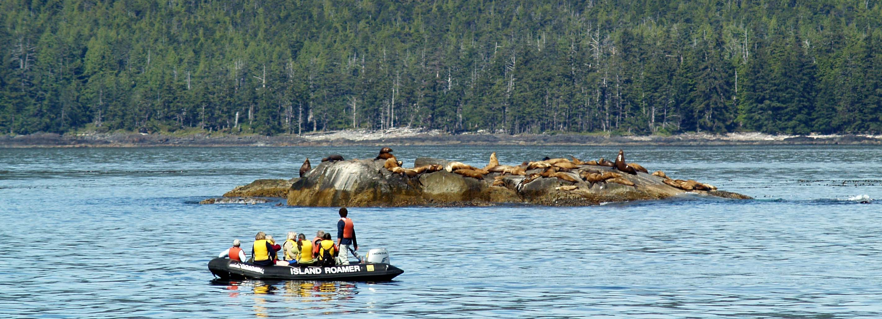
Wilderness Tourism Association of BC www.wtabc.ca
Thank You

